Slide 1


Slide 2
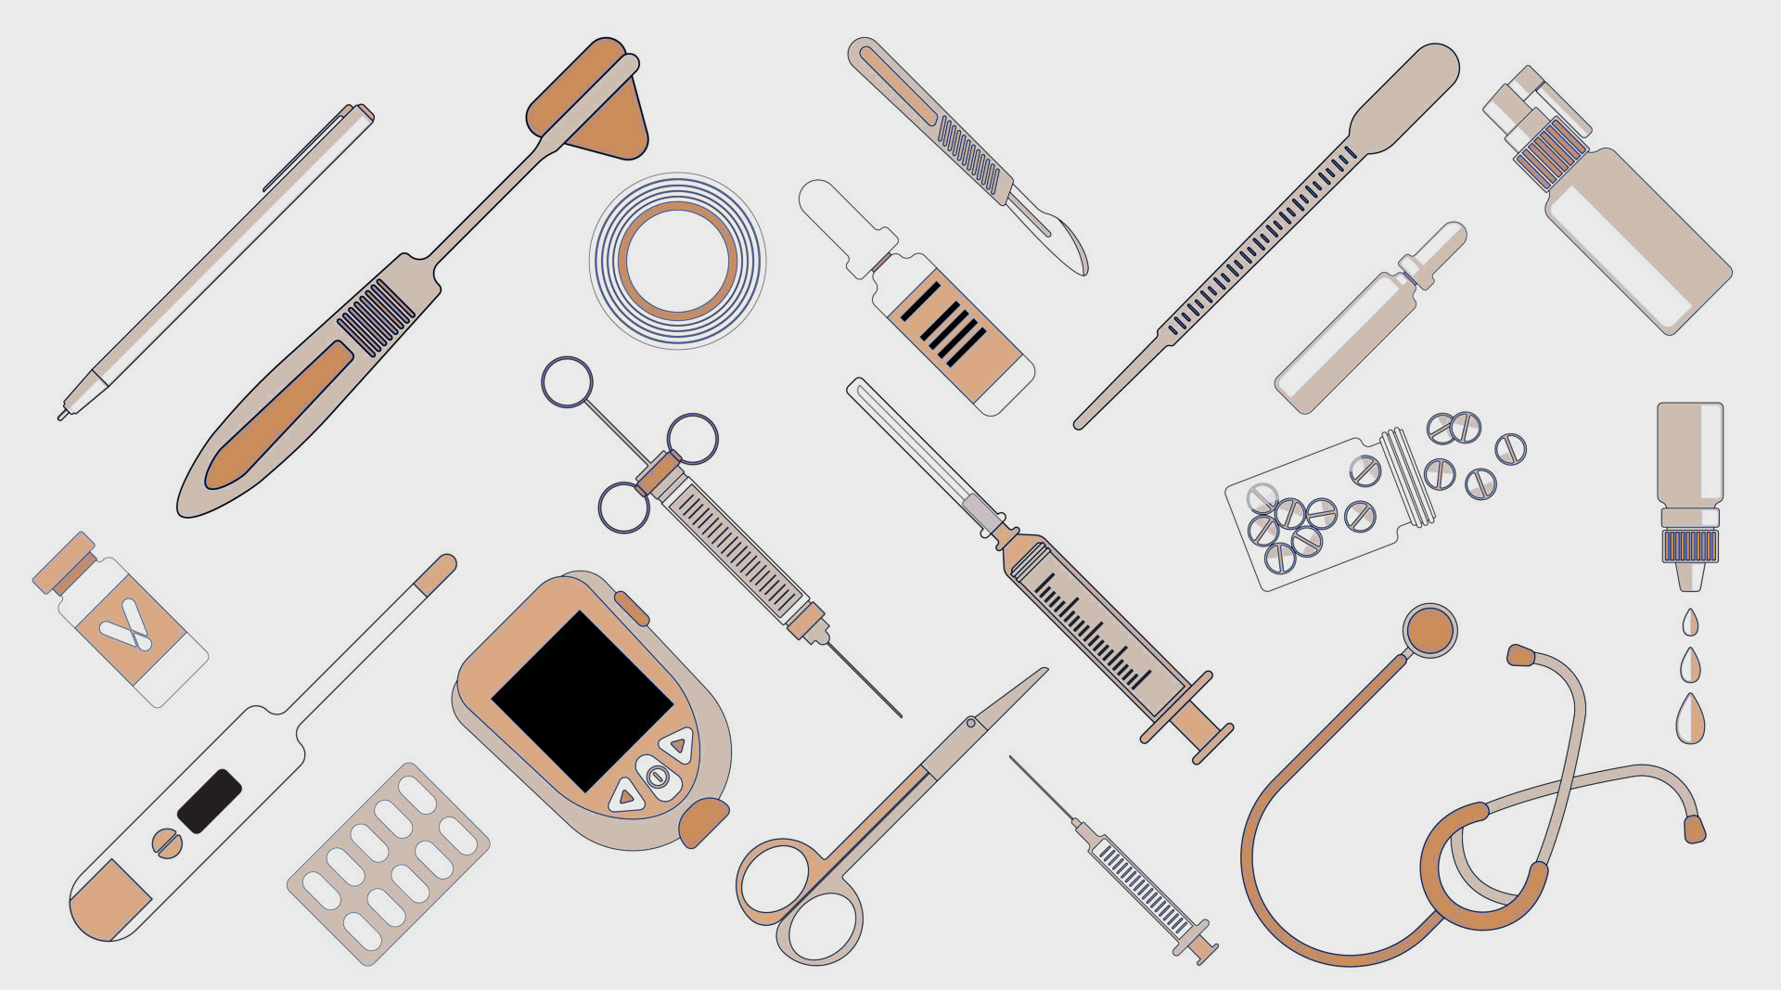
Who is MTG
MTG is a company that specializes in the registration of medical devices, ensuring that they meet the necessary technical and safety requirements before being used by healthcare professionals.

Slide 3

Company Structure
MTG is a medical device registration company that provides regulatory and clinical services for the medical device industry. Our team consists of experienced professionals in the fields of regulatory affairs, clinical research, and toxicology.

Slide 4
Main activities of the company
Medical Device Registration Process
MTG helps medical device manufacturers navigate the complex process of registering their products with regulatory authorities.
Technical Testing of Medical Devices
Our team of experts conducts technical testing to ensure that medical devices meet regulatory standards for safety and effectiveness.
Toxicological Studies of Medical Devices
We also conduct toxicological studies to assess the potential risks associated with using medical devices.
Clinical Trials of Medical Devices
MTG can help medical device manufacturers design and conduct clinical trials to demonstrate the safety and effectiveness of their products.
Working with Medical and Preventive Institutions
We work closely with medical and preventive institutions to ensure that our clients' products meet the needs of healthcare professionals and patients.

Slide 5
Medical device registration process
Technical testing of medical devices
Toxicological studies of medical devices
Clinical trials of medical devices
Before a medical device can be registered, it must undergo technical testing to ensure its safety and effectiveness. This testing is typically performed by accredited laboratories and includes evaluations of the device's design, materials, and performance.
In addition to technical testing, medical devices must also undergo toxicological studies to assess their potential impact on human health. These studies evaluate the device's biocompatibility, toxicity, and other safety factors.
After technical testing and toxicological studies are completed, medical devices must undergo clinical trials to evaluate their safety and effectiveness in human subjects. These trials are typically conducted in multiple phases and involve a range of participants, from healthy volunteers to patients with the target condition.

Slide 6

Medical Device Registration Process

Slide 7

Collection and execution of technical and operational documentation
Collection and verification of the registration dossier. Preparation of the electronic archive.
Conducting toxicological studies
Client
Collection of administrative documents (powers of attorney, certificates, registrations, etc.)
Conducting technical tests
Payment of state fees for registration and examination of the quality of efficacy and safety of a medical device.
Selection and approval of a testing center/LPU for conducting tests
Conducting tests on EMC parameters (if necessary)
MTG
Carrying out tests for the purpose of type approval of measuring instruments (if necessary)
Approval of the Application and its annex
Commercial offer/Contract
Submission of the dossier to Roszdravnadzor
Calculation of sample quantities. Importation of samples for testing / Travel to the place of MI production
Conducting clinical/clinical-laboratory tests

Slide 8
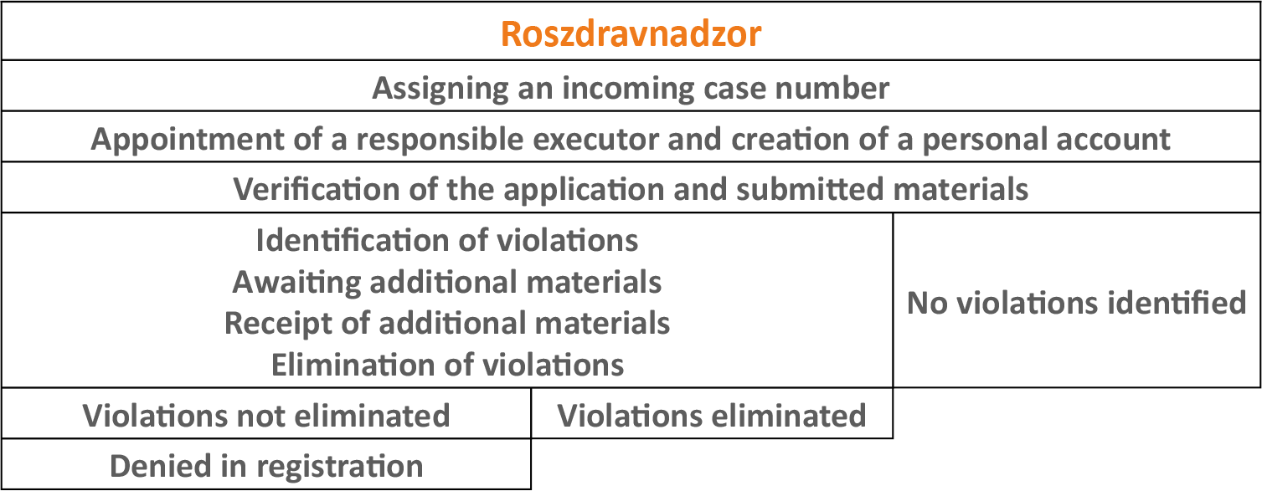
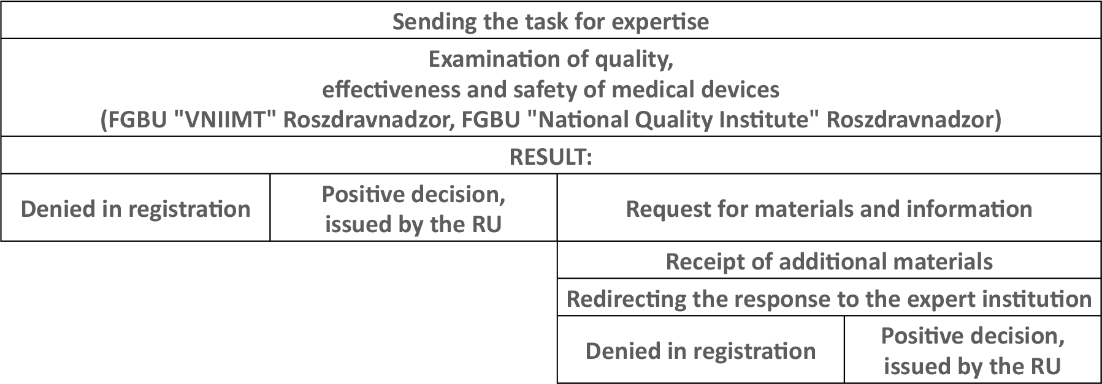

Slide 9

Technical Testing of Medical Devices

Slide 10
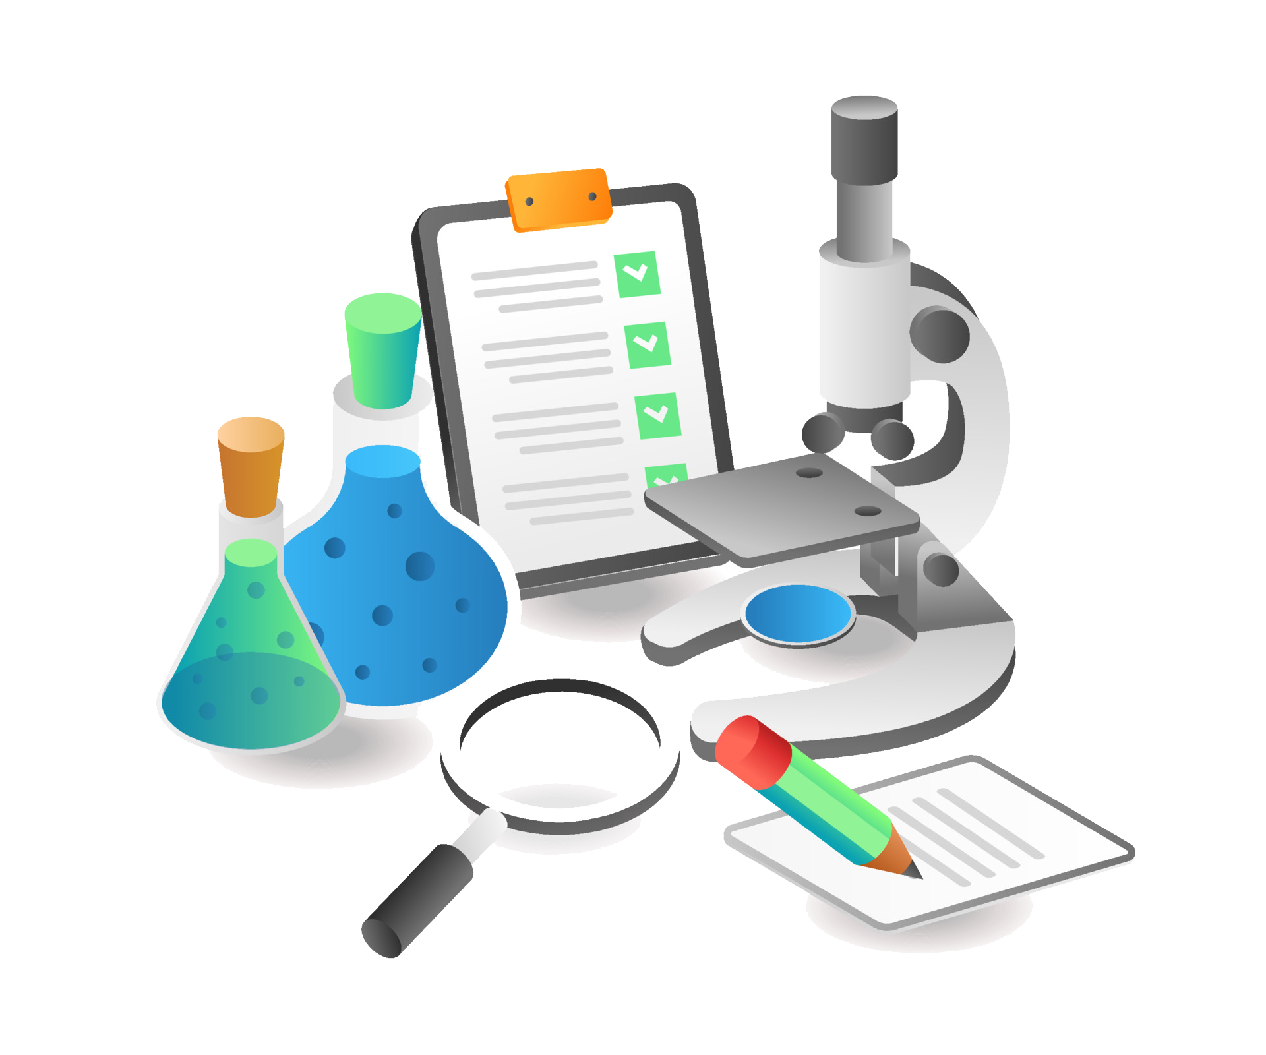
Toxicological studies of medical devices
Toxicological studies are an important part of the medical device registration process. These studies are conducted to evaluate the safety of the medical device and its components.
Types of Toxicological Studies
There are several types of toxicological studies that may be conducted during the medical device registration process, including:
Acute toxicity studies
Subchronic toxicity studies
Chronic toxicity studies
Genotoxicity studies
Carcinogenicity studies
Purpose of Toxicological Studies
The purpose of toxicological studies is to evaluate the potential adverse effects of the medical device and its components on human health. These studies help to identify any potential risks associated with the use of the medical device.

Slide 11
Clinical trials of medical devices
At MTG, we understand the importance of clinical trials in the process of medical device registration. Clinical trials are conducted to evaluate the safety and effectiveness of medical devices before they are approved for use by the general public. Our clinical trial process involves the following steps:
We analyze the documents and prepare the Act, Program and Protocol of clinical trials with appendices, conduct a literature search, request additional materials from the customer if necessary;
We conclude an agreement with the medical and preventive institution to conduct clinical trials of a medical device, after obtaining a clinical trial permit for the medical device in question;
We provide the medical institution with a sample of the product for examination (samples are usually subject to return), all necessary documents from the customer in electronic form, contracts and archives in paper form.
Analysis of the data collected during the clinical trial to determine the safety and effectiveness of the medical device.
Our clinical trial process is designed to ensure that all medical devices registered by MTG are safe and effective for use by the general public. We work closely with medical and preventive institutions to ensure that our clinical trials are conducted in accordance with established guidelines and regulations.

Slide 12
The process of working with medical and preventive institutions
At MTG, we work closely with medical and preventive institutions to ensure that our registered medical devices are being used effectively and safely. Our process involves the following steps:
Identifying potential partners in the medical and preventive fields
Establishing communication and building relationships with these partners
Providing education and training on the proper use and maintenance of our medical devices
Collaborating on research and development projects to improve our products and services

Slide 13
Thank You
We appreciate your time and attention. If you have any further questions or would like to learn more about our services, please don't hesitate to contact us.
Contact Information
MTG Med Tech Garant
MOSCOW, UL. MARSHALA KATUKOVA, 16
Phone. +7 (495) 748-84-48
Email: co@m-t-g.ru

